Slide 1
The Klear Influencer Marketing
Rate Card

Slide 2
Influencer Rates
Successfully defining a marketing budget requires a clear understanding of all relevant channels. However, marketers are often left in the dark when budgeting for influencer marketing.
To help brands best estimate influencer marketing pricing, we analyzed real pricing data collected from over 2,500 influencers across the leading social networks to bring you the “Klear Influencer Marketing Rate Card”.
This Rate Card is the most thorough study on the market, for the first time enabling brands to budget by network, content, and influencer type.
We hope this comprehensive understanding of industry rates empowers marketers with the tools to develop a successful influencer marketing strategy in 2019.
This report is brought to you by Klear, the industry standard for influencer marketing, providing the only comprehensive research on influencer pricing and market rates. The study sampled the largest pool of influencers, offering the most extensive research on the market.
Study:
Surveyed 2,500+ international Influencers* across 3 major social networks (Instagram, YouTube, and Facebook), between Jan 1 - Dec 31, 2018
Performed a statistical analysis of trends and demographics using our SIGIR award-winning influencer measurement technology
*Influencers ranged in follower count and industry types
The Price of Influencer Marketing

Slide 3
Influencer Rates
A survey of 2,500+ influencers rates, from Jan 2019 – Mar 2019
 | Post | Video | Story | Video | Post
Nano 500-5K Followers | $100 | $114 | $43 | $315 | $31
Micro 5-30K Followers | $172 | $219 | $73 | $908 | $218
Power 30-500K Followers | $507 | $775 | $210 | $782 | $243
Celebrity 500K+ Followers | $2,085 | $3,138 | $721 | $3,857 | $2,400
The Price of Influencer Marketing

Slide 4
$721
Influencer Rates:
Instagram Stories
Introduced in 2016, Instagram stories allows users to share an image or a video that will vanish after 24-hours.
Stories have been growing in popularity, surpassing Snapchat in daily usage. So, unsurprisingly, In 2018, 1-in-3 sponsored posts on Instagram were stories.
$210
$73
$43
Nano
Micro
Power
Celebrity
Fun Fact | By early 2017 Instagram Stories had more daily views than Snapchat
The Price of Influencer Marketing

Slide 5
$3,318
Influencer Rates:
Instagram Videos
Instagram videos were introduced in 2013, for moments that require more than a static image to tell
a story.
Brands have begun to leverage this formation in their marketing strategy. And, by 2018, 11.3% of sponsored #ad feed posts on Instagram were videos.
$775
$219
$114
Nano
Micro
Power
Celebrity
Fun Fact | Justin Beiber was the first celebrity to reach 1M likes for an Instagram video
The Price of Influencer Marketing

Slide 6
Influencer Rates:
Instagram Post
$2,058
With over 800 million monthly active users, Instagram is an ideal platform for brands looking to establish an authentic connection with current and potential customers.
Currently Instagram is the best performing platform for influencer marketing. And, while there are three mediums to present content (posts,
videos, and stories) static images (posts) have maintained popularity amongst marketers.
$507
$172
$100
Nano
Micro
Power
Celebrity
Fun Fact | As of April 2019, “photo of an egg” is the most liked Instagram post with 53.2M likes
The Price of Influencer Marketing

Slide 7
$3,857
Influencer Rates:
YouTube
For brands looking to create long-form content, YouTube is the go-to platform. And, it’s where many influencers got their start and grew their following.
However, due to time and effort required to produce video content, YouTube is the most expensive social channel. Long videos average $1234, two time more expensive than short videos at $656.
$908
$782
$315
Nano
Micro
Power
Celebrity
Fun Fact | The Indian record label T-Series is the most popular YouTube channel
with 94.5M subscribers
The Price of Influencer Marketing

Slide 8
Influencer Rates:
Facebook Post
$2,400
While Facebook is the original social network, it is the least popular platform for influencer campaigns. And, thought marketers do prioritize
other networks for influencer campaigns, on Facebook Celebrities still charge significant fees.
In 2018, Food and Lifestyle were the most expensive industries for influencer marketing on Facebook.
$243
$218
$31
Nano
Micro
Power
Celebrity
Fun Fact | Lifestyle is the most expensive influencer category on Facebook,
averaging $351 a post
The Price of Influencer Marketing

Slide 9
Men Avg. Price
$459
Women Avg. Price
$351
Influencer Pricing
Trends: Gender
Across all social channels Women charge an average of $351 while Men charge $459.
However, men make just 23% of the influencer industry.
Men
23%
Women
77%
Not Fun Fact | In general the average woman earns 77 cents to every dollar a man earns
The Price of Influencer Marketing

Slide 10
Influencer Pricing
Trends: Pay Gap
By Channel
YouTube
38%
YouTube is the channel with the highest pay gap between male and female influencers, 6% greater than Instagram.. It is also the most expensive platform for influencer marketing.
Instagram
32%
The Price of Influencer Marketing

Slide 11
Lifestyle
Men
$672
Influencer Pricing
Trends: Pay Gap
By Industry
Women
$466
Travel is the industry with the highest male representation, but female travel influencers earn more. The lifestyle industry has significantly more female influencers, yet on average men earn $200 more per post.
Travel
Men
$570
Women
$615
The Price of Influencer Marketing

Slide 12
Lifestyle
Travel
Influencer Pricing
Trends: Gender Demographics By
Industry
Men
39%
Men
12%
Women
88%
Women
61%
The Price of Influencer Marketing

Slide 13
*Top 5 Regions
Influencer Pricing
Trends: Geo
US
$475
46% of Influencer activity occurs in the US, making it the most popular region for influencer campaigns. However, pricing in this region does not differ significantly from the UK and Canada, less popular markets.
Perhaps, the over-saturation of US influencers has impacted pricing in the popular region.
UK
$470
Canada
$447
Germany
$368
Italy
$315
Fun Fact | Sweden, Estonia, and South Korea are up and coming regions
for influencer marketing
The Price of Influencer Marketing

Slide 14
Industry
Influencer Pricing
Trends: Industry
Travel
$5,335
Travel is the most expensive category, averaging $5,335
a post and 9X more expensive
than the second most expensive category Fashion .
Prices may be dependent on
the time and effort in creating content, with travel being a
more extensive category.
Fashion
$549
Technology
$490
Food
$472
Entertainment
$353
Fun Fact | Travel’s high cost is due to production time and effort, with many
posts utilizing video
The Price of Influencer Marketing

Slide 15
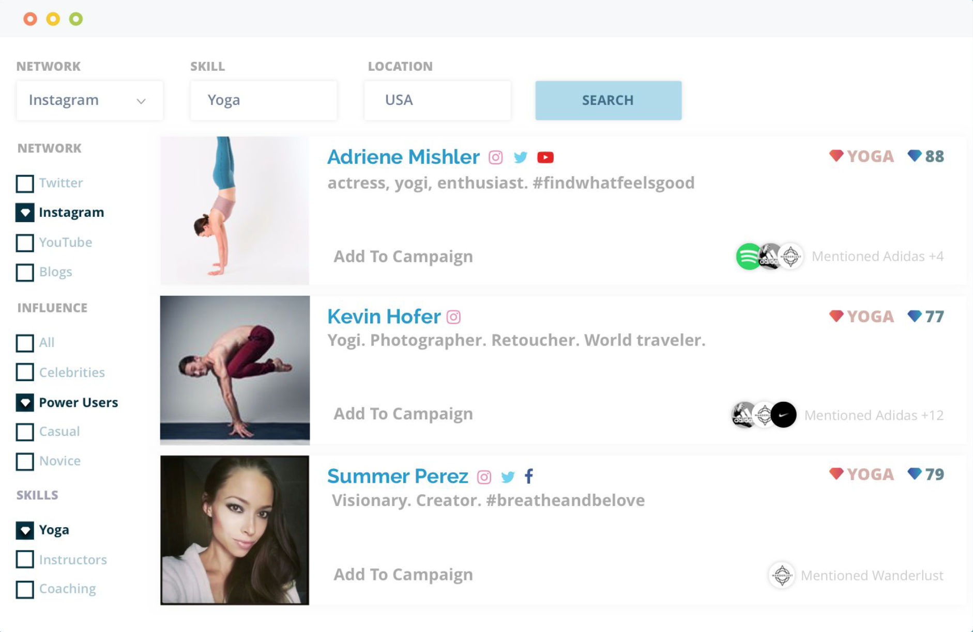
The New Standard in Influencer Marketing
Klear is the leading influencer marketing platform for Fortune 500 brands and agencies.
Powered by award-winning influencer measurement technology, Klear is setting a new market standard for finding social creators, assessing influence and measuring ROI.
Learn more at klear.com

