Slide 1
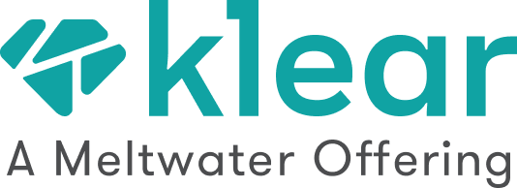
Influencer Marketing Plan
<Your Name, Influencer Strategist @ Brand>

Slide 2
Why We Need
Influencer Marketing
10.52 | Influencer campaigns earned media value for every $1.00 of paid media
92% | Consumers trust recommendations from other people
100m | Monthly spend by brands on Instagram influencer advertisement
Customers trust influencers. That’s why 86% of marketers are using influencer marketing.
We can’t stay behind.

Slide 3
Our Influencer Marketing Efforts
No. of Influencers we are in touch with | <50>
Earned Mentions by Influencers | <225>
Earned Impressions by Influencers | <25,000,000>
We are focusing on influencers that have authority in <sports> and <running>, with high amplification potential on <Twitter/Instagram> and audience demographics that fit our target audience.

Slide 4
My Brand
My Brand
How Influencers Mentioned Us
@Influencer
@OurChampion
Really happy to tell you that @myBrand are stocking my By samantha Lashes in selected stores & online
These are the top mentions
of our brand by Influencers.
Hey there @myBrand I like your new advert and the song
2,016 Impressions
116 Likes

Slide 5
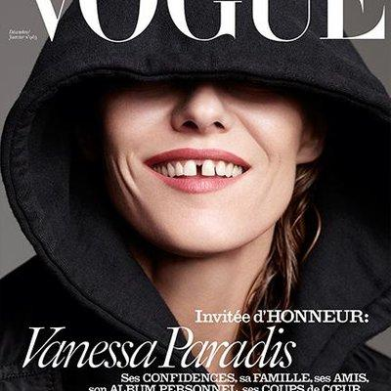
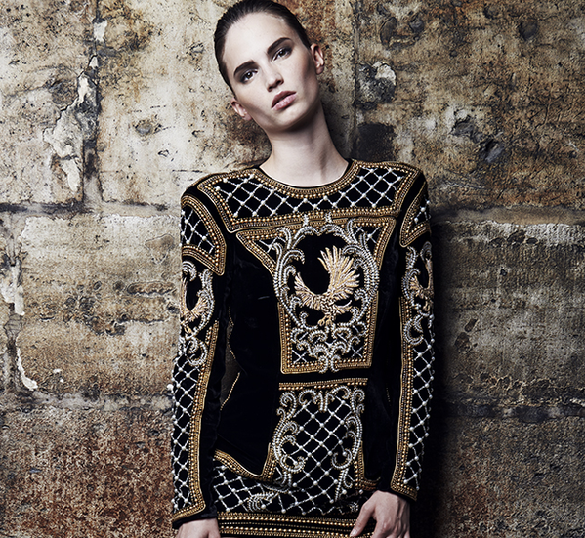
1st Competitor
2nd Competitor
@NeverHeardOfYou
@VeryRelevant
Competitors’ Influencers
These influencers are engaged with our competitors and we should draw their attention.
I’m In Love With This Brand
I divide my life to before & after meeting this brand.
3,023 Impressions
563 Likes

Slide 6
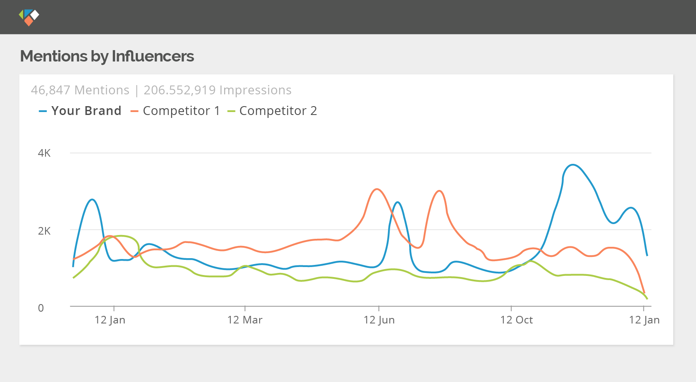
Our Influencer Marketing Benchmarked
This is the impact we gained from influencer marketing, benchmarked to our competitors.

Slide 7
Social
Networks
Focus
Most Trending Networks In Our Industry
Where We’re Active On
Where Our Competitors Are Active On
We have established great presence in some social networks and we need to make sure we are always where our potential target audience and influencers thrive

Slide 8
Identify 150 New Relevant Influencers
Focus on Topic1 Influencers in which were lacking
Perk Campaign (T-Shirt, Beta Product Access, News)
Company Event / Conference
Quarterly Checkup
Competition / Hashtag Campaign
Add More Activities
Influencer Marketing Activities
Select the Activities You Will Be Focusing On

Slide 9
 | Last Year | This Year
No. of Influencers we are in touch with | <50> | <150>
Earned Mentions by Influencers | <225> | <750>
New Influencers Activation Rate | <37%> | <60%>
Earned Impressions by Influencers | <25,000,000> | <650,000,000>
Our Influencer Marketing Efforts
We are focusing on influencers that have authority in <sports> and <running>, with high amplification potential on <Twitter/Instagram> and audience demographics that fit our target audience.

Slide 10
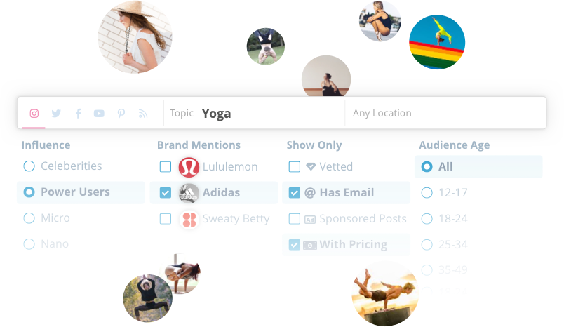
The New Standard in Influencer Marketing
Klear is the leading influencer marketing platform for Fortune 500 brands and agencies.
Powered by award-winning influencer measurement technology, Klear is setting a new market standard for finding social creators, assessing influence and measuring ROI.
Learn more at klear.com
Brought to you by Klear, the leading influencer marketing platform for Fortune 500 brands and agencies.

