Slide 1
WHY IMPROVING PASSWORD MANAGEMENT MATTERS
IDENTITY AND ACCESS MANAGEMENT 101 AND GETTING STARTED WITH DASHLANE
DATE

Slide 2
Speaker Name
Speaker Title
WELCOME!
Notes:
Speaker introduces themselves, provides welcoming / opening thoughts Thanks for joining today, we’re looking forward to sharing some insights with you around IAM or Identity and Access Management, and talk about strategies for securing your data and your organization.

Slide 3
IDENTITY AND ACCESS MANAGEMENT
Chapter One
101
Notes:
Let’s start with a high-level look at what IAM is and why it matters.

Slide 4
IAM 101
IAM HELPS YOU SEE EVERY PART OF A CYBERSECURITY VULNERABILITY.
CHAPTER ONE
Notes:
Judging your cybersecurity without the right tech is like measuring an iceberg from the waterline up. It’s not going to give you the full picture of risk. IAM helps you see below the waterline to find where you’re most vulnerable.

Slide 5
IAM 101
RIGHT PEOPLE.
RIGHT ACCESS.
CHAPTER ONE
RIGHT REASONS.
Notes:
So what is IAM? Gartner Research defines IAM as “the discipline that enables the right individuals to access the right resources at the right times for the right reasons.” In a nutshell, IAM helps you flexibly but securely assign access to your resources.

Slide 6
IAM 101
WHY DOES IAM MATTER NOW?
80%
of organizations are pursuing digital innovation faster than they can improve their security practices to defend against cyberattacks
Remote work is the new standard
CHAPTER ONE
The use of personal equipment for work tasks is on the rise across businesses
SOURCE: 2020 DATA BREACH INVESTIGATIONS REPORT, VERIZON, 2020
Shared networks and cloud computing are the standard
The regulatory environment is constantly changing
Notes:
The world of cybersecurity is changing constantly, and success can feel like a moving target thanks to big changes in how we work, where we work, and how we regulate cybersecurity. Organizations must also consider regulatory legislation such as the EU’s General Data Protection Regulation (GDPR) and the California Consumer Privacy Act (CCPA). Organizations are trying to rise to the occasion, but a vast majority feel they are pursuing digital innovation faster than they can improve their security.

Slide 7
IAM 101
THREATS ARE ON THE RISE — AND THE STAKES ARE HIGH.
“The financial impact can be cataclysmic, particularly for smaller businesses. The average cost of business disruption caused by a breach was even steeper at $1.9 million, a 57% surge since 2017. It’s not surprising, then, that an estimated 50% of small and medium companies go out of business within six months of an attack.”
CHAPTER ONE
SOURCE: US SECURITIES AND EXCHANGE COMMISSION, THE NEED FOR GREATER FOCUS ON THE CYBERSECURITY CHALLENGES FACING SMALL AND MIDSIZE BUSINESSES, OCTOBER 19, 2015
Notes:
A recent study finds that the frequency of incidents involving theft of credentials per organization has tripled. And the costs are high for organizations: an estimated 50% of SMBs go out of business within six months of an attack.

Slide 8
IAM 101
IAM CAN HELP IN A BIG WAY
Lower risk of data breaches With SSO and MFA, your employees no longer have to remember and type multiple passwords.
Improved user experience and productivity Employees can securely access the applications and data they need from anywhere. This can improve the user experience and bump up productivity.
CHAPTER ONE
Enhanced regulatory compliance IAM automates data access and privacy requirements by controlling who can access, use, and share data.
Reduced IT costs IAM automates and standardizes many aspects of identity, authentication, and authorization management. It can, for instance, decrease help desk tickets for password resets and streamline onboarding and offboarding of users.
Centralized management IAM centralizes and automates IT management, giving IT teams the flexibility to work in the office or from remote sites.
Notes:
Implementing an IAM program can help secure your resources and your company’s wellbeing for five big reasons. First, IAM lowers the risk of data breaches by securing resources; it improves user experience and productivity by putting the right resources within reach; it enhances regulatory compliance; helps manage and reduce IT costs (and hours); and it provides centralized management during a time when employees use their own devices, work from home, and more.

Slide 9
SECURING YOUR DIGITAL ASSETS
Chapter Two
Notes:
A crucial part of IAM is securing your digital assets

Slide 10
51%
Securing your digital assets
of employees reuse passwords across business and personal accounts
YOUR IAM IS ONLY AS STRONG AS YOUR PASSWORD SECURITY. But across organizations, password security hasn’t kept up with growth.
80%
CHAPTER TWO
of hacking related breaches are due to weak, stolen or defaulted passwords
Notes:
An IAM program is only as strong as a password security protocol; Password security is the first-line of defense for an organization, and also the the path of least resistance for cybercriminals. And it makes sense: Why should they try to force their way into your IT environment when they can simply log in? And many security solutions are only designed to detect intrusions; once attackers are inside, it takes an average of 280 days to identify and contain a data breach.

Slide 11
Securing your digital assets
A FEW FACTORS COULD BE EXPOSING YOUR CORPORATE PASSWORDS
Weak credential storage and sharing
CHAPTER TWO
Malicious or careless insiders
Hacking
SOURCE: US SECURITIES AND EXCHANGE COMMISSION, THE NEED FOR GREATER FOCUS ON THE CYBERSECURITY CHALLENGES FACING SMALL AND MIDSIZE BUSINESSES, OCTOBER 19, 2015
Notes:
Passwords can be exposed in a number of ways; hackers or malicious insiders could identity or share them. But just as likely, they could be exposed by accident, through weak storage and sharing processes or careless but well intended users.

Slide 12
Securing your digital assets
PASSWORD MANAGERS CAN ADD NEW LAYERS OF PROTECTION
Identify and eliminate weak and reused passwords
CHAPTER TWO
Requires only one password to remember
Gives coworkers ability to securely share passwords
Separate personal and business credentials
Notes:
Passwords managers add new layers of protection to your IAM by identifying and eliminating vulnerable passwords across your organization. Instead of employees saving their passwords in unsecured documents or stickies (or reusing them), they remember a single password for the manager; the password manager gives them tools to securely share passwords and protected resources, and importantly, it helps separate out personal and business credentials.

Slide 13
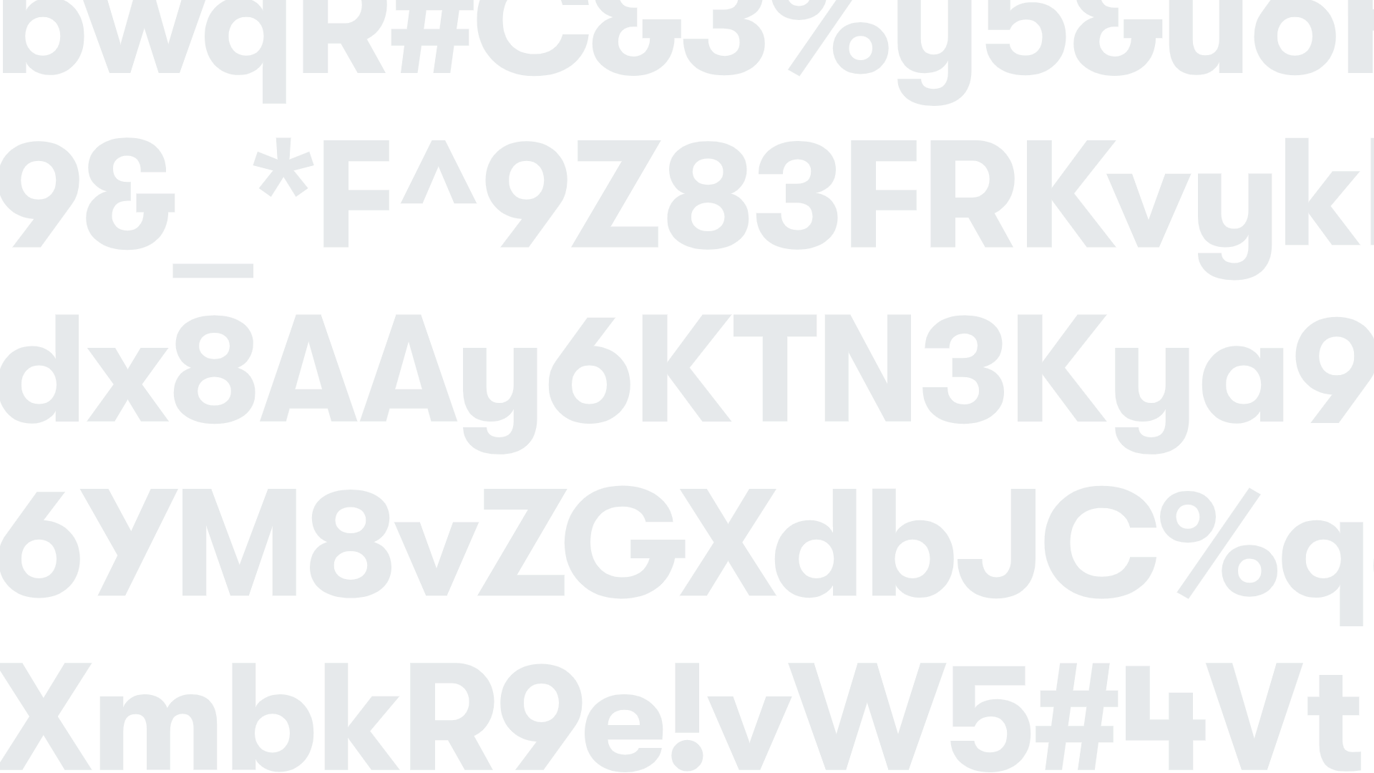
Securing your digital assets
MITIGATING RISK MEANS IMPLEMENTING A PASSWORD MANAGER
CHAPTER TWO
Make it easy for employees to follow best practices for passwords
Give IT admins insights into the health of passwords across the organization
Monitor the dark web for compromised personal information so you can protect your accounts
Notes:
A password manager helps shore up password related cyberattacks by helping employees learn better password hygiene, but it also gives IT admins tools to monitor their organization as well as the dark web.

Slide 14
Securing your digital assets
NOT ALL PASSWORD MANAGERS ARE CREATED EQUAL
A password management solution should be easy to deploy, simple to use, and entirely secure. It should also come with a few key features:
CHAPTER TWO
Password generator
Admin dashboard
Group sharing
Dark web monitoring
Password health reporting
Notes:
A great password manager fits seamlessly into your “business as usual.” But it should also come with features that help you manage and maintain your organization’s password — and security — health.

Slide 15
Securing your digital assets
DASHLANE MAKES PASSWORD MANAGEMENT SIMPLE
We’ve helped over 15 million users and over 20,000 companies in 180 countries to dash across the internet without compromising on security. Admins can easily onboard, offboard, and manage their employees with the assurance that company data is safe. Employees can enjoy a way to manage their work and personal accounts that’s already loved by millions.
CHAPTER TWO
Notes:
At Dashlane, this is what we do, all day every day. Helping bring secure access to organizations across the globe, removing the burden of security and access, and making employees a bigger part of their organization’s cybersecurity story.

Slide 16
HOW TO GET STARTED WITH A PASSWORD MANAGER
Chapter Three
Notes:
So let’s say that you’re ready to adopt a password manager. But what are the best ways to implement one? And how can you make sure you’re successful in doing so?

Slide 17
SIX STRATEGIES FOR EFFECTIVELY IMPLEMENTING A PASSWORD MANAGER
How to get started with a password manager
1.
Launch organization-wide across teams and departments
2.
Understand deployment options for users
3.
Set your new password policies
CHAPTER THREE
4.
Kickstart conversations about security
5.
Communicate your policy changes
6.
Conduct employee training
Notes:
So as we wrap up, a few important takeaways around IAM and password management. As we discussed, risks are on the rise, and the cost of not implementing IAM can be massive. With dark web activity and breaches on the rise, weak passwords are one key culprit, whether they are shared purposefully or inadvertently. A password manager can be your organization’s first line of defense, provided it gives you access to a few must-haves.

Slide 18
WRAPPING UP
Chapter Four

Slide 19
Wrapping Up
SIX TAKEAWAYS ON IAM AND PASSWORD MANAGEMENT
Growing risks The number of data breaches due to weak, stolen, or default passwords is on the rise. Steep costs In addition to the high cost of mitigation, consequences can include loss of customers, adverse brand reputation, litigation, and regulatory fines. Dark web and breaches Cybercriminals can easily find stolen corporate passwords on the dark web — for lease, sale, and even free. Because many employees reuse passwords, a single data breach can expose all your corporate accounts.
Weak passwords Your employees can contribute to theft of credentials, whether they’re acting maliciously or inadvertently. The frequency of incidents involving credential theft due to insiders has tripled per organization since 2016. Password managers Secure and easy to use, password managers protect access to your organization’s critical data and assets without compromising user productivity. Password manager must-haves Password managers should have a password generator, group sharing capabilities, options to see password score over time, a flexible admin dashboard, and dark web monitoring.
CHAPTER FOUR
Notes:
First, it’s important that a password manager be adopted company-wide, across all teams and departments. If only a small fraction of your team implement a solution like Dashlane, it still leaves your work vulnerable. Second, understand how your organization can and will deploy a new password manager. This will be crucial in setting new password policies and protocols. From there, get talking: start conversations about security across the organization to get buy in and shape your policies. These policies can then be communicated to employees through trainings, conversations and more.

Slide 20
Wrapping Up
Many organizations rush to implement a password manager after they’ve been breached. Think proactively instead. Incorporate a password management solution into your risk-management strategy. By approaching deployment strategically, you’ll not only avoid negative impacts to workflows but also improve your overall security posture.
DASH FORWARD
CHAPTER FOUR
Notes:
And as one final though, it’s natural for organizations to rush into response mode after a breach. But we’ve seen that it’s much more helpful to think proactively and to incorporate password managed into your risk-management strategy early on.

Slide 21
Notes:
[Speaker opens webinar to questions and comments]

Slide 22
Thank you!
DASHLANE.COM SPEAKERMAIL@DASHLANE.COM

